Slide 1
Microsoft Dynamics 365 Business Central inspectorMAN

Slide 2
Agenda
Setup inspectorMAN
Setting-up an embargo
working at documents

Slide 3
setup inspectorMAN

Slide 4
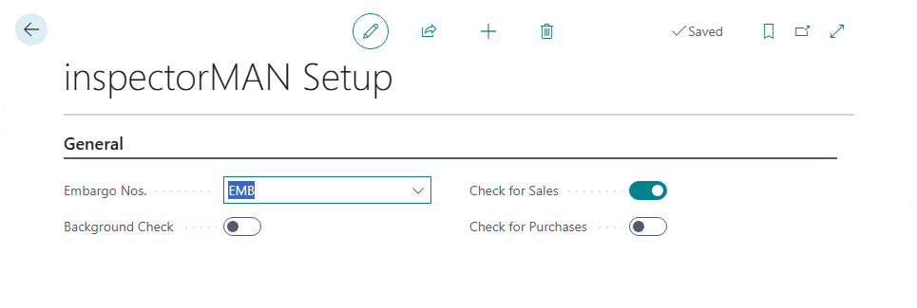
setup inspectorMAN
Setup the inspectorMAN
setup the number series
enable background check, without getting popup messages
enable checkup for sales or/and purchase

Slide 5
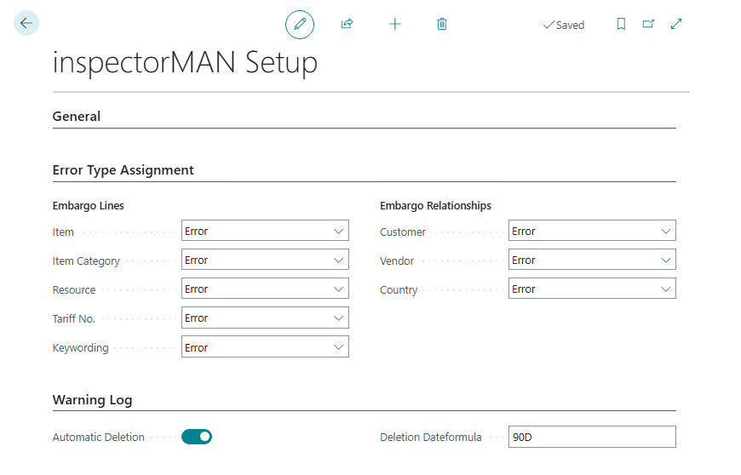
setup inspectorMAN
Setup the inspectorMAN
error handling messaging with check document and additional warning
enable also automatically deletion for warning messages after definied period
Notes:
additional warnings are possible to setup them at the embargo lines and related customer, vendor or country.
here you can setup the general setting

Slide 6
setting-up an embargo

Slide 7
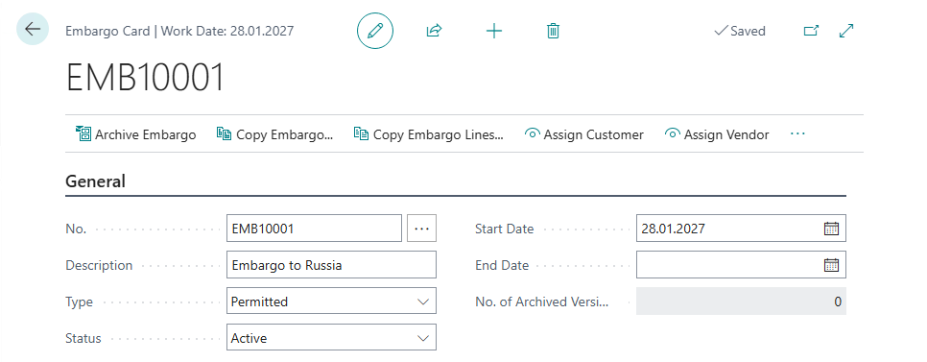
setting-up an embargo
create an embargo with individual parameters (e.g. start / end date, description…)
specify the type – permitted or not permitted
if you are ready, set the status of active

Slide 8
setting-up an embargo
assign customer, vendors and countries to an embargo

Slide 9
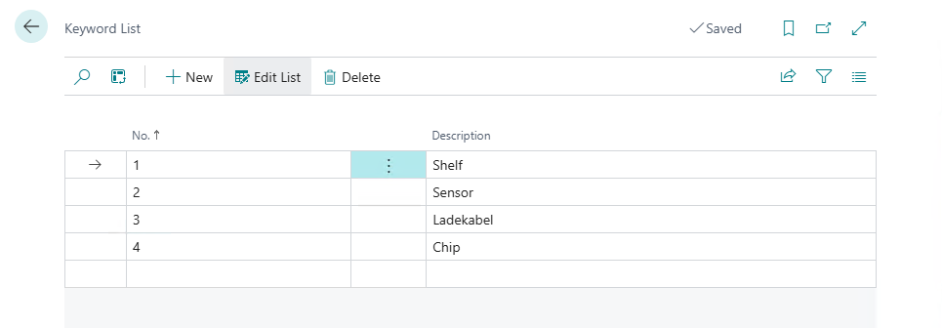
setting-up an embargo
create keywords in the keyword list for filtering descriptions again those settings
you can select them on the embargo lines FastTab
optimization search by using regular expressions at the description field
Notes:
put the keyword on the item card.
this field has maximum 255 characters
here you can also use RegEx parameters

Slide 10
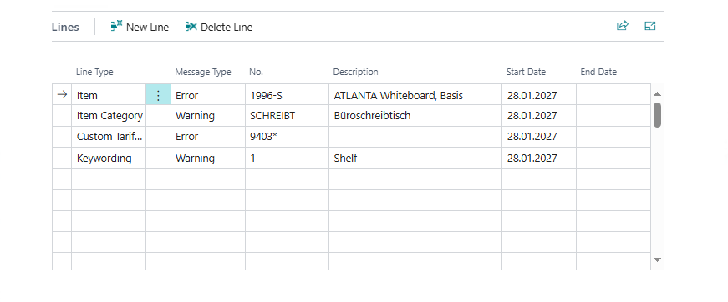
setting-up an embargo
fill in the type of object, embargoes will reference to
use item, item catagory, ressource, customs tariff no. or keywords
you can also work with wildcard at customs tariff no. for filtering a complete area of permitted tariff nos.

Slide 11
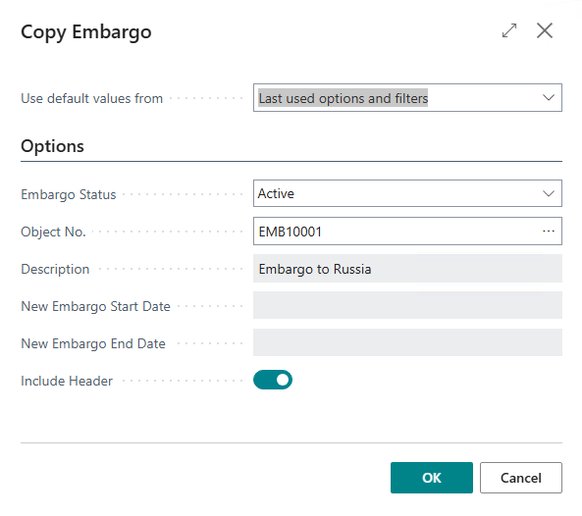
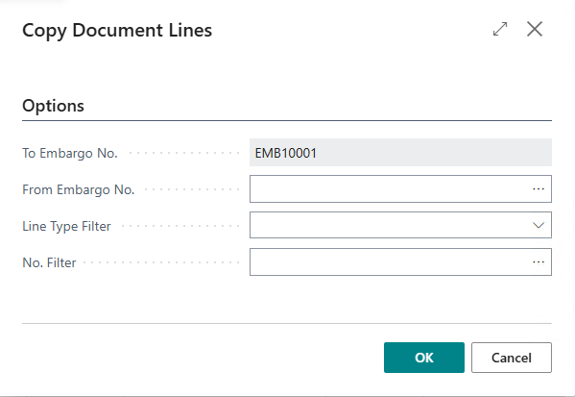
setting-up an embargo
archive an embargo record the changes you make
setting-up a new, copy embargo from archive or copy embargo lines from active embargoes

Slide 12
working at documents

Slide 13
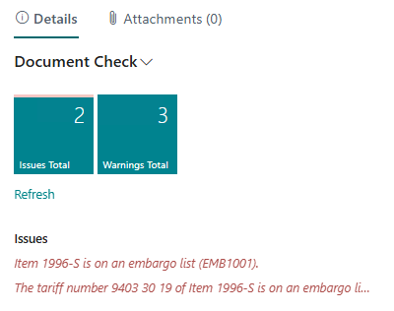
working at documents
embargoes are ready for sales and purchase. Use them to protect yourself again sanctions of foreign countries.
At the sales order entry, document check* identifiy the sanctions of an active embargo
*the document check needs to be enabled to inform users by messaging of warnings

Slide 14
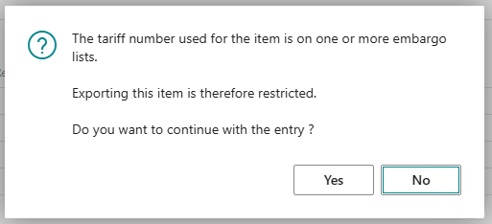
working at documents
on the lines FastTab, entries for items and ressouces will also be checked
dependend on your settings, the system appears messages to inform the user about a running sanction

Slide 15
Thank you very much!

